Slide 1
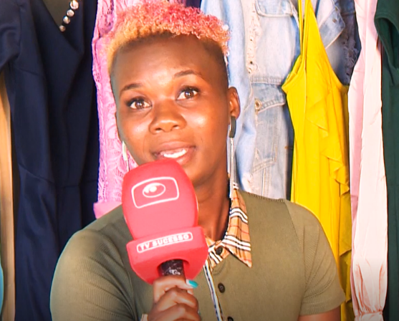



Market Systems Symposium
Deep Dive on Social Inclusion
Working with media to influence gender norms and increase incomes
May 11th 2022

Slide 2
Constraint: Gaps in information, education and social expectations drive lower performance of women-owned businesses
Models
Broadcast gender sensitive entrepreneurship content on Mozambican TV, radio, social media and IVR
Create an enabling environment wherein large numbers of female micro-entrepreneurs have improved information access, confidence and acceptance.
Expected Impact
Change gender norms on women in business & agriculture
Increase women’s access to information, incomes and economic empowerment
Change the way media actors view and finance gender-sensitive entrepreneurship content

Slide 3





Media sector in
Mozambique
Opportunities
18%
Share of population that uses internet ¹
Market Constraints
84%
Share of urban population that watches TV everyday ²
Few TV programs tailored to entrepreneurship for low income population Little variety of media channels for BOP Lack of sector competitiveness Content is poor quality/ doesn’t boost learning/increase women’s confidence Few TV companies produce their own specialized content,
Research shows that low-income women in urban areas are more interested in watching TV than listening to radio – but for rural women, community radio is more relevant ³
35%
Share of urban population that listen to radio every day⁴
2.30m
that Facebook reaches (40% women) ⁵
Television
Internet
Radio
¹ Mozambique Digital 2019
² Intercampus do Grupo GfK, 2011 study
³ WIN survey, 2020
⁴ Intercampus do Grupo GfK, 2011 study
⁵Ideialab extract in We Are Social and HootSuite study
⁶ Ipsos monthly Audience tracker
Print
⁶

Slide 4

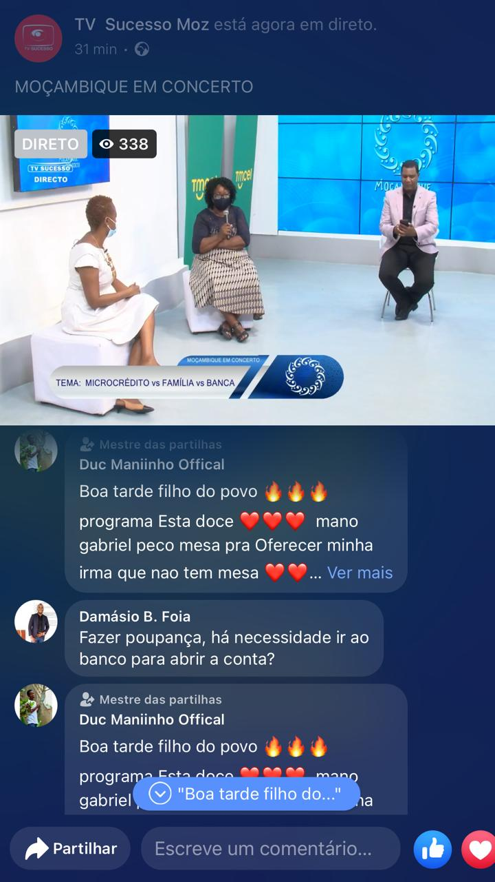
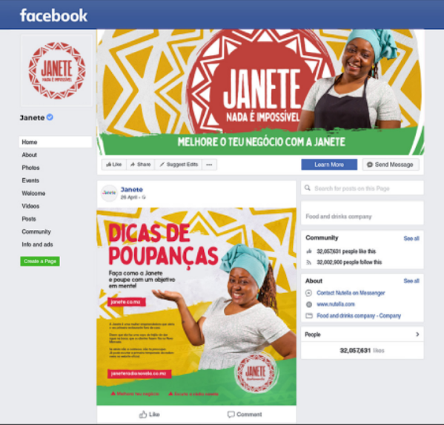

What we’ve done
Escola do Agricultor
Production and broadcast of a TV and radio show focused on agricultural good practices.
TV Sucesso
Production of a segment in a popular TV show showcasing female micro-entrepreneurs and business experts on different topics every week.
Janete
First a radionovela that reached 40,000 female micro-entrepreneurs,
Now a social media multiplatform to be sponsored by different actors.
TV Miramar
Broadcast of thought provoking content on gender and entrepreneurship to increase awareness of these topics on most popular news program

Slide 5
Results to date
16,360 women have greater economic empowerment
45,488 women have adopted improved business practices
354,495 women are accessing new information
Through TV, radio, IVR and social media channels

Slide 6
Be intentional about strategy and design
1
2
3
Innovative impact measurement
Sustainability models
Do your homework, learn about your target group’s consumption habits
Diversify your approach on multiple platforms to ensure greater reach of low income women
Promote the shows widely (e.g. radio or TV spots)
Tailor your content to target audience and channels, choose shows with largest (BOP) audience
Innovate through edutainment (radionovela, talk show, news show) – while incorporating a gender lense
If you have resources, go with an audience tracking company. We:
Added impact questions
Tracked exposed and non exposed audience
Baseline, midline and endline
Rigour: Work closely with the service provider
Adaptive management: Course correct (e.g. survey scripts)
Innovation (ideal if little resources)
Quizzes with awards (database) for program design and adaptation and impact measurement
Use social media
IVR analytics for impact measurement of exposed
Our focus is to secure financial sustainability of these programs and test new financial models
Product placement through social media (Janete)
Media convening to bring media and financers together
Anchor partners
  Looking to replicate and increase visibility through partners, service providers and events
  Build the capacity of producers or technical partners to create content
Notes:
Obvious We were uncertain at the beginning so we really investigated our assumptions before hand
what they like to watch or listen to, when, what other programs have done to create meaningful contente
(radio, IVR, TV, Social media)

Slide 7
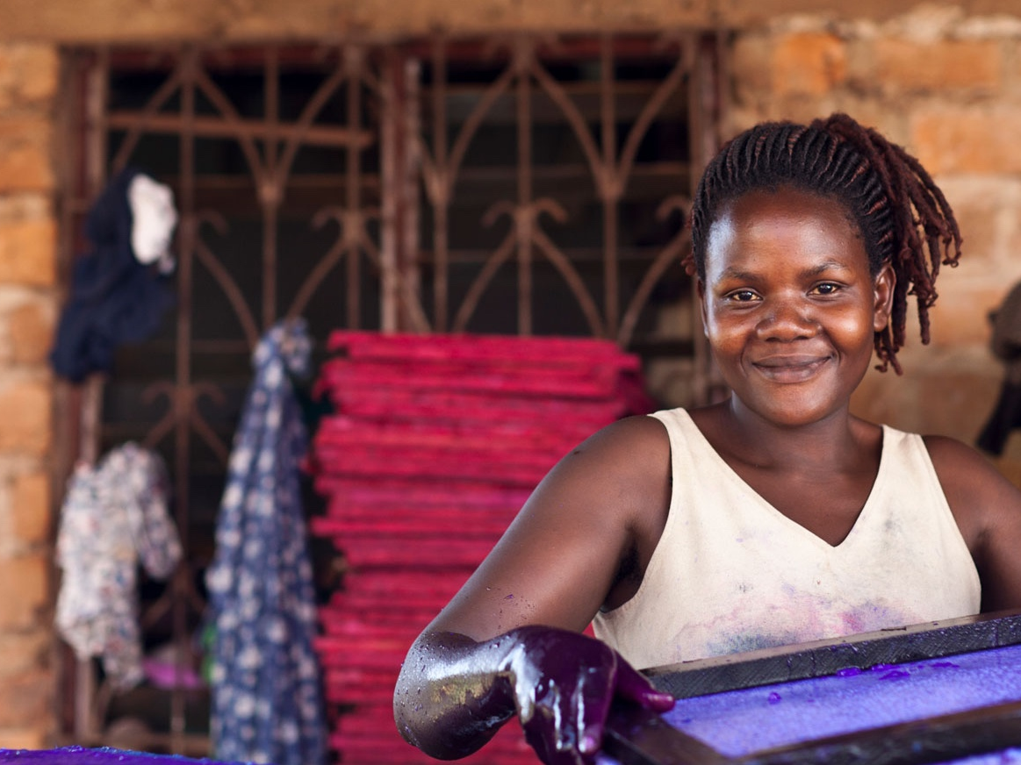


Thank you!

